Slide 1


AUDIO
COMPRESSION

Slide 2
KEY PEOPLE
NGUON KRONGLY
TEP RATHNA
CHEA CHANDYNA
CHHIT LEAKHENA
TE HENGLAY
CHHENG LEAKHENA
KAING SOKHARITH
THOU REAKSA

Slide 3


COMPANY / PRODUCT HISTORY
STEP 2
STEP 4
Apply Singular Value Decomposition (SVD)
Reconstruct the Spectrogram
STEP 1
STEP 3
STEP 5
Convert Audio to Spectrogram
Compression (Reducing Rank)
Compare the Results

Slide 4
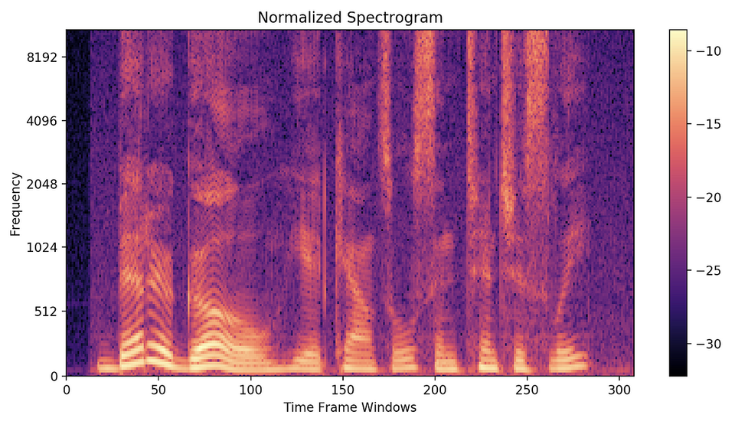
STEP ONE
Convert Audio to Spectrogram
The script first loads the audio file using librosa.load().
Then, it converts the audio into a spectrogram using Short-Time Fourier Transform (STFT).
A spectrogram represents the frequencies present in the audio over time.
It’s a 2D matrix where :
Rows represent different frequency components.
Columns represent different time slices.

Slide 5
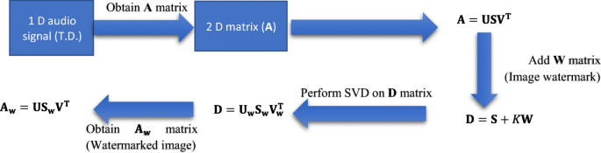
STEP TWO
Apply Singular Value Decomposition (SVD)
The script performs SVD on the spectrogram, which factorizes the matrix into three smaller matrices: D=U⋅S⋅VTD = U \cdot S \cdot V^TD=U⋅S⋅VT
U contains the frequency information.
S is a diagonal matrix with singular values (which represent the strength of each frequency component).
V^T contains time information.

Slide 6
STEP THREE
Compression (Reducing Rank)
Instead of keeping all singular values in S, we zero out smaller singular values beyond a certain rank.
This removes less important frequency components while preserving the dominant patterns.
This effectively reduces the amount of data stored in the spectrogram, compressing the audio.
STEP FOUR
Reconstruct the Spectrogram
After removing smaller singular values, the script reconstructs a new, compressed spectrogram: Dcompressed=U⋅Scompressed⋅VTD_{compressed} = U \cdot S_{compressed} \cdot V^TDcompressed=U⋅Scompressed⋅VT
•Then, it uses the Inverse STFT (ISTFT) to convert the spectrogram back into an audio waveform.

Slide 7
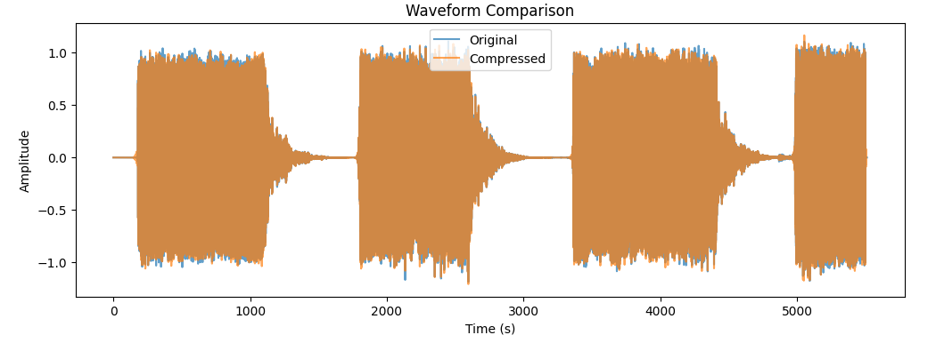
STEP FIVE
Compare the Results

Slide 8
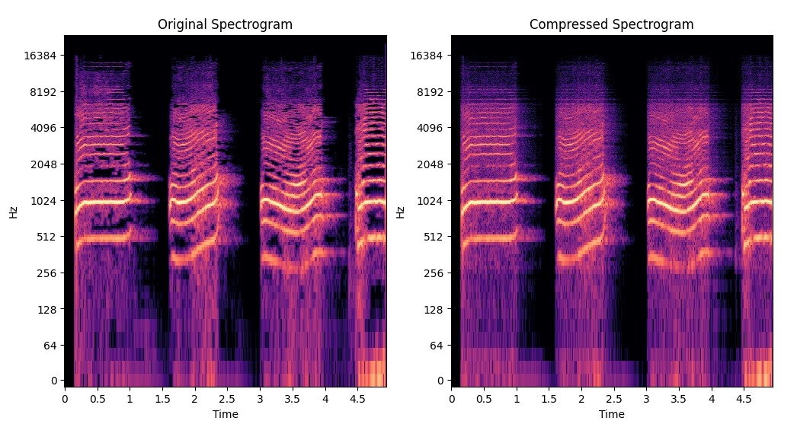
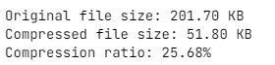
STEP FIVE
Compare the Results

Slide 9


CODE
ALT + TAB
TO VIEW THE CODE

Slide 10




ANY QUESTION ?

Slide 11

THANK YOU

